Slide 1
Introduction to Embedded Systems using Arduino
Session 1: Introduction
Dr Ciaran MacNamee

Slide 2
Internet of Things and Embedded Systems
The Internet of Things (IoT) allows embedded systems to communicate using the Internet
So, what are embedded systems?
They are:
Computer Systems used for a specific purpose mostly inside a bigger electrical or mechanical system – everyday objects
Provide Intelligence in everything from wearables to cars and beyond
Notes:
A definition of the Internet of Things: the interconnection via the Internet of computing devices embedded in everyday objects, enabling them to send and receive data.

Slide 3
Embedded Systems are all around
Computers are found everywhere … Not just in ‘computers’
E.g., a car might have hundreds of embedded computers in it
Mobile Phones, MicroWave ovens, washing machines, TVs, remote controls etc all incorporate Microcontrollers or Microprocessors
The modem you use for home Internet is an embedded computer
An electronic toy might be an embedded computer

Slide 4
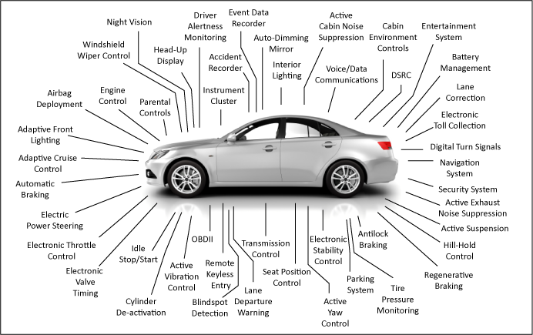
In your car …

Slide 5
Microcontrollers
Usually, we say that an embedded system contains a microcontroller
A microcontroller is a microcomputer that contains most of its input/output peripherals and the memory it needs along with a CPU on a single IC chip
Around for over 45 years: Intel 8051 (8-bit CPU, released in 1980) was one of the earliest MCUs and is still widely used
You find it everywhere – window winders in a car, intelligent payment systems – the list is very long
Other processors include 6801 (sold in billions), PIC, etc
Atmel (now Microchip) ATmega328P is found in the Arduino UNO
ATmega4809 is found in the Arduino Nano Every
ARM 32-bit MCU has become the dominant 32-bit microcontroller

Slide 6
Microcontroller Families
Most microcontrollers come in ranges of families
So you get many types of 8051: they differ in the amount of memory, the peripherals (types of I/O) they have, the packages they come in, and so on
Usually you pay for what you get: more memory and I/O costs more
Embedded systems are extremely cost sensitive
Try to use the cheapest possible microcontroller that will do the job

Slide 7
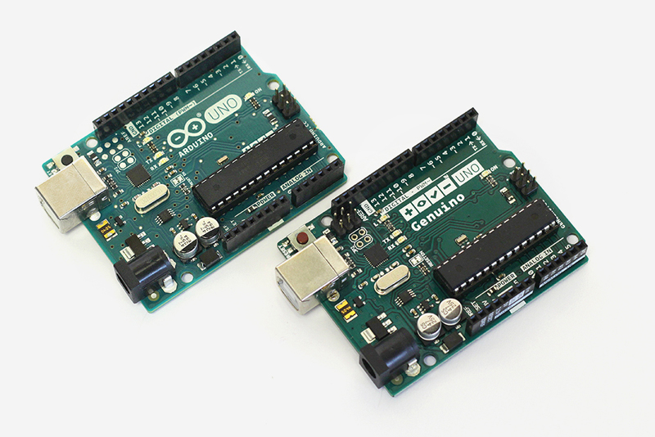
Platforms
Many companies provide development platforms that are simple low-cost ways of getting started in embedded systems
Arduino UNO R3 is a great place to start
Arduino UNO has a microcontroller called ATMega328P
Also has connectors that let you connect other boards (called Shields) to the Arduino
You can make a useful ‘real-world’ embedded system easily

Slide 8
Atmel AVR
The Arduino we use contains an Atmel 8-bit AVR microcontroller
It’s widely used, simple to program and has good (free) development tools
It has quite a lot of memory and a wide range of I/O and peripherals
Designed to be programmed in C so its architecture is logical and regular

Slide 9
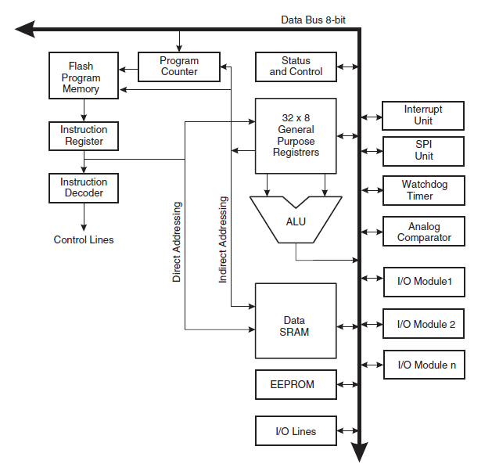
Atmel AVR
Program Memory
On-chip IO
devices
ATMega328P is a member of the AVR microcontroller family
AVR Microcontroller:
ATMega328P is the microcontroller in an Arduino UNO Board
So here we can see the CPU, the I/O devices and the memories
CPU
Data Memory

Slide 10
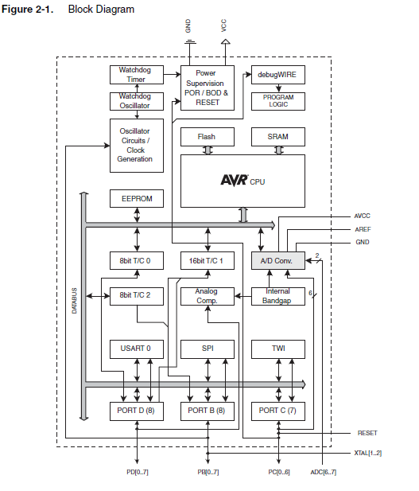
ATMega328P
ATMega328P has program and data memory.
How much program (Flash) memory does it have?
How much data memory (RAM or SRAM) does it have?
This is the microcontroller in an Arduino UNO R3

Slide 11
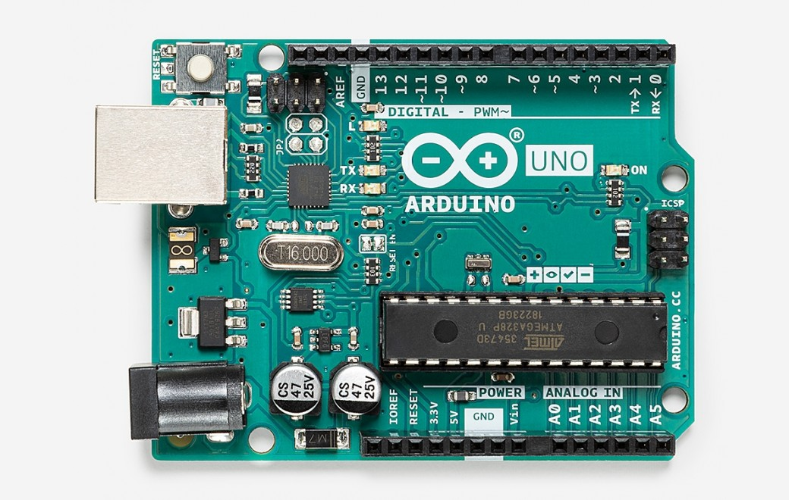
Arduino UNO R3
Arduino is an open-source programming and hardware platform (www.arduino.cc)
Originally for hobbyists, beginners, non-programmers
Now very widely used
Uses its own software platform which hides a lot of details from the programmer
Also has a lot of support boards and software
https://store.arduino.cc/arduino-uno-rev3

Slide 12
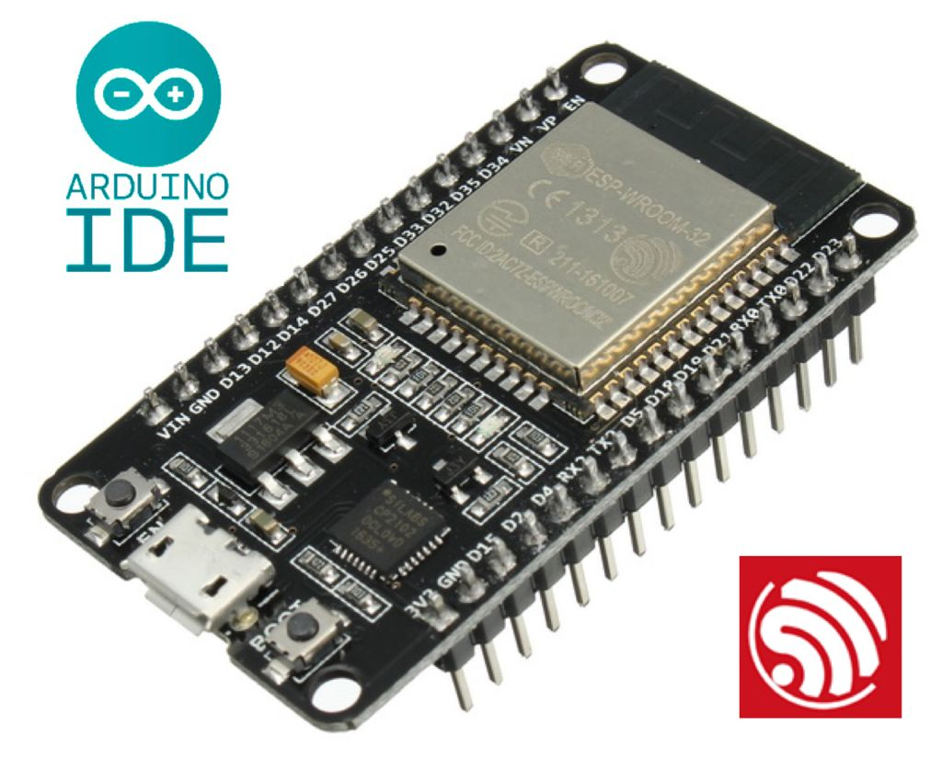
Arduino IDE: not just for Arduinos
ESP32 is a series of low cost, low power system on a chip microcontrollers with integrated Wi-Fi and dual-mode Bluetooth. ... ESP32 is created and developed by Espressif Systems, a Shanghai-based Chinese company.
Arduino IDE can be used for other microcontrollers, as well as the boards that are made by Arduino
Here’s a tutorial that explains how to use the Arduino IDE to program ESP32:
https://randomnerdtutorials.com/installing-the-esp32-board-in-arduino-ide-windows-instructions/
If you want to use Arduino for a new microcontroller, you must be sure that there are libraries available to support it.
This takes a lot of work – somebody has to do it!

Slide 13
Newer Arduino families
Originally you had Arduino UNO and Mega – used 8-bit AVR microcontrollers
Also, Arduino Nano, similar or higher performance Arduinos
Arduino MKR boards use 32-bit ARM M0 microcontrollers
Arduino MKR1010 has on-board WiFi and Bluetooth
Arduino MKR1310 has on-board LoRaWAN (Low Power Long Range wireless interface).
Arduino UNO R4 and Nano R4 have 32-bit microcontrollers
Arduino Q supports powerful AI applications

Slide 14
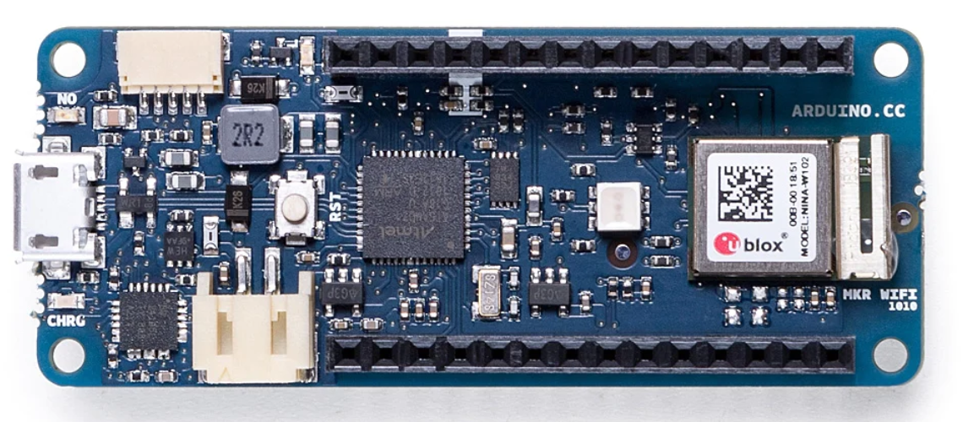
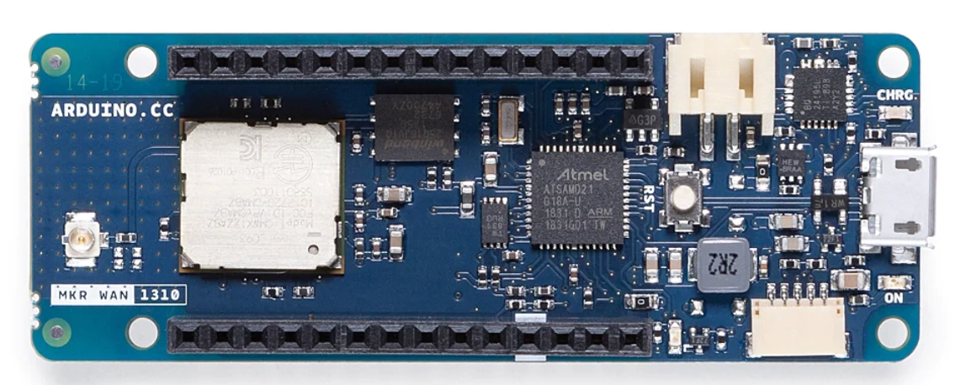
MKR1010 WiFi and MKR1310 LoRaWAN
MKR1010
MKR1310

Slide 15
Arduino MKR1010 WiFi Specifications
Microcontroller | SAMD21 Cortex®-M0+ 32bit low power ARM® MCU
Radio module | u-blox NINA-W102
Board Power Supply (USB/VIN) | 5V
Secure Element | ATECC508
Supported Battery | Li-Po Single Cell, 3.7V, 1024mAh Minimum
Circuit Operating Voltage | 3.3V
Digital I/O Pins | 8
PWM Pins | 13 (0 .. 8, 10, 12, 18 / A3, 19 / A4)
UART | 1
SPI | 1
I2C | 1
Analog Input Pins | 7 (ADC 8/10/12 bit)
Analog Output Pins | 1 (DAC 10 bit)
External Interrupts | 10 (0, 1, 4, 5, 6, 7, 8,9, 16 / A1, 17 / A2)
DC Current per I/O Pin | 7 mA
CPU Flash Memory | 256 KB (internal)
SRAM | 32 KB
EEPROM | no
Clock Speed | 32.768 kHz (RTC), 48 MHz
LED_BUILTIN | 6
USB | Full-Speed USB Device and embedded Host

Slide 16
Arduino MKR1310 LoRaWAN Specifications
Microcontroller | SAMD21 Cortex®-M0+ 32bit low power ARM MCU
Radio module | CMWX1ZZABZ
Board Power Supply (USB/VIN) | 5V
Secure Element | ATECC508
Circuit Operating Voltage | 3.3V
Digital I/O Pins | 8
PWM Pins | 13 (0 .. 8, 10, 12, 18 / A3, 19 / A4)
UART | 1
SPI | 1
I2C | 1
Analog Input Pins | 7 (ADC 8/10/12 bit)
Analog Output Pins | 1 (DAC 10 bit)
External Interrupts | 8 (0, 1, 4, 5, 6, 7, 8, 16 / A1, 17 / A2)
DC Current per I/O Pin | 7 mA
CPU Flash Memory | 256 KB (internal)
QSPI Flash Memory | 2MByte (external)
SRAM | 32 KB
Clock Speed | 32.768 kHz (RTC), 48 MHz
LED_BUILTIN | 6
USB | Full-Speed USB Device and embedded Host
Antenna gain | 2dB (bundled pentaband antenna)
Carrier frequency | 433/868/915 MHz

Slide 17
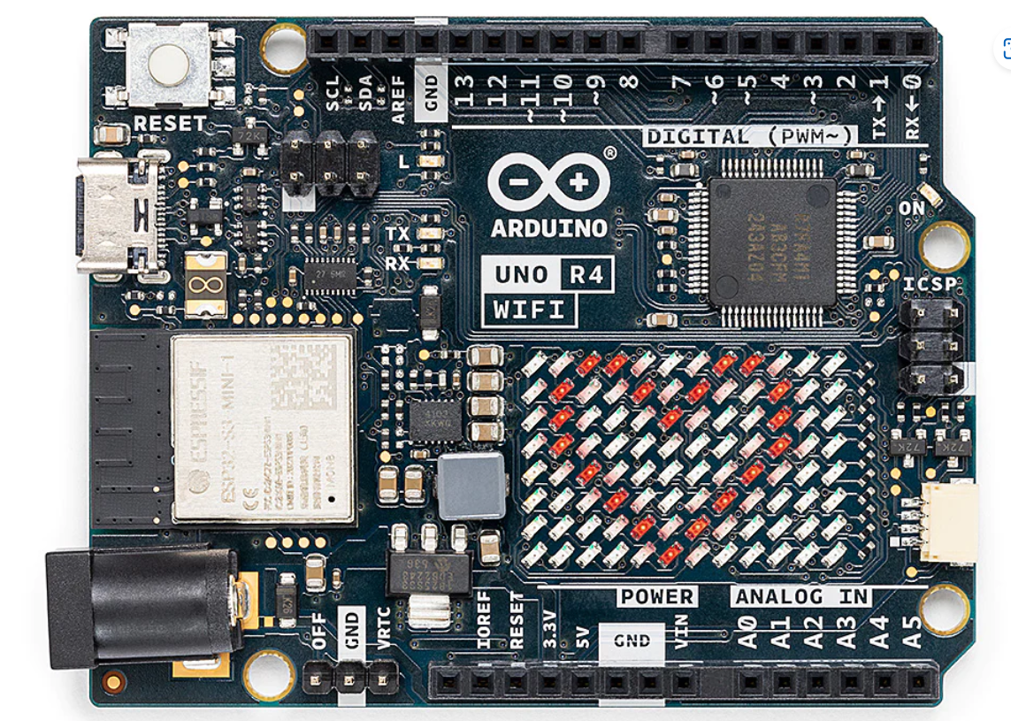
New (July 2023) Arduino UNO R4 & R4 WiFi
Board | Name | Arduino® UNO R4 WiFi
 | SKU | ABX00087
Microcontroller | Renesas RA4M1 (Arm® Cortex®-M4)
+ ESP32 based WiFi

Slide 18
Arduino UNO R3 Specifications
32 kBytes of Flash program memory
2 kByte of RAM
16 MHz
Inputs and Outputs
14 digital input/output pins
6 analog input pins
6 “analog” output pins (not quite analog, really PWM outputs – we can use it for DC motors)
Completely stand-alone: doesn’t need a computer once programmed
For now, we’ll use the standard Arduino UNO R3. It’s powerful enough for our needs

Slide 19
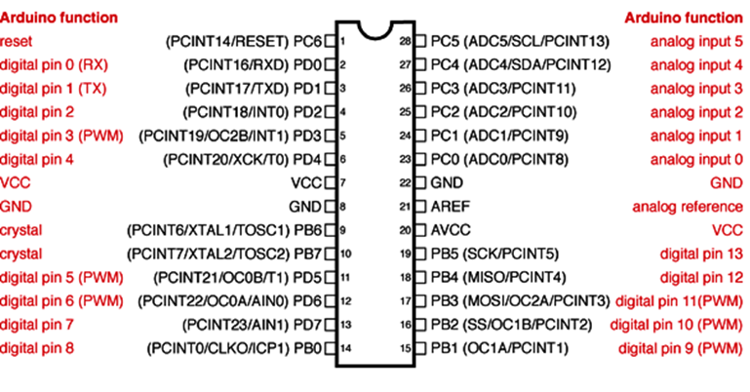
Arduino - ATMega328P Mapping
Applies to the DIP package only

Slide 20
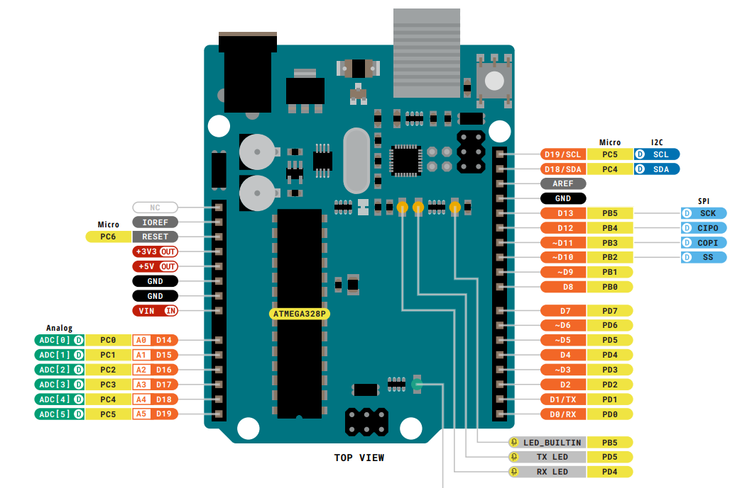
Arduino Uno R3 Pin connections
(UNO R3 Revision has some extra pins for I2C)

Slide 21
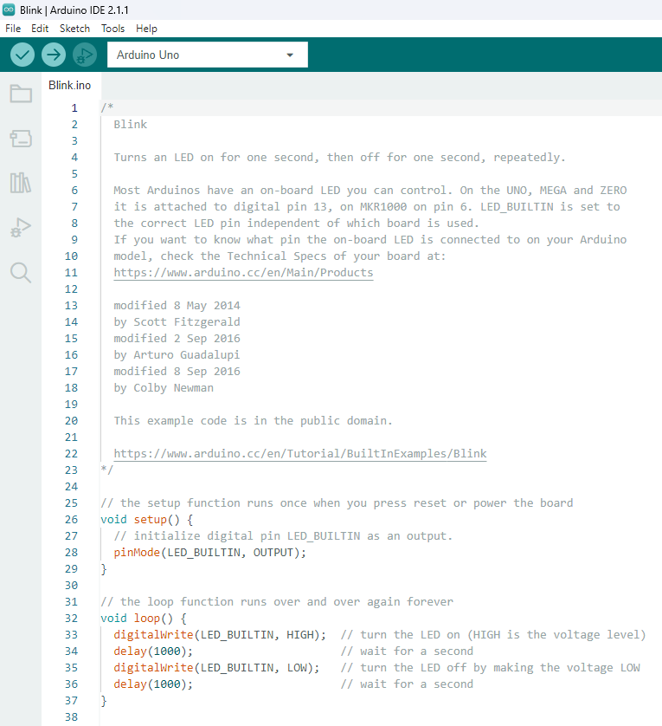
An Arduino Sketch
Arduino Programs have
A setup() part
A loop() part

Slide 22
What do we see here?
The Arduino sketch has two blocks: setup() and loop()
The first block, setup() is where you initialise the microcontroller to make it do what you want
So ‘blink’ starts by setting pin 13 to be an output: pinMode(LED_BUILTIN, OUTPUT);
This runs once, when the program starts

Slide 23
After setup()
After setup() the program runs loop()
Unlike setup(), loop() runs forever
It’s like a while (1) or for(;;) loop in C
So what’s in loop() happens forever
Until you take away power
So digitalWrite(LED_BUILTIN, HIGH); sets Pin 13 (an output now) HIGH turning on the LED
And digitalWrite(LED_BUILTIN, LOW); sets Pin 13 (an output now) LOW turning off the LED

Slide 24
Hidden Treasure (for C programmers)
int main(void)
{
init(); // initializes the Arduino hardware
setup();
for (;;)
loop();
return 0;
}
This is what is actually happening
It’s why loop() goes on forever

Slide 25
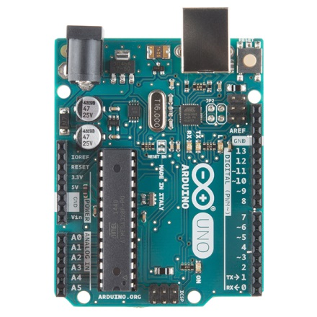
Blink running
Pin 13 is connected to this LED on Arduino
This is Pin 13
Question: why do you think delay(1000); is included in Blink?

Slide 26
Some Common Commands
The next few slides are mostly for reference
You can find these details (and more) at www.arduino.cc
Serial.println(value); Prints the value to the Serial Monitor on your computer
pinMode(pin, mode); Configures a digital pin to read (input) or write (output) a digital value
digitalRead(pin); Reads a digital value (HIGH or LOW) on a pin set for input
digitalWrite(pin, value); Writes the digital value (HIGH or LOW) to a pin set for output
delay(value)
Stops the program execution for the number of milliseconds given by value

Slide 27
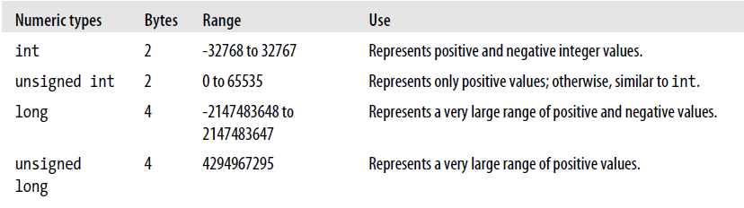
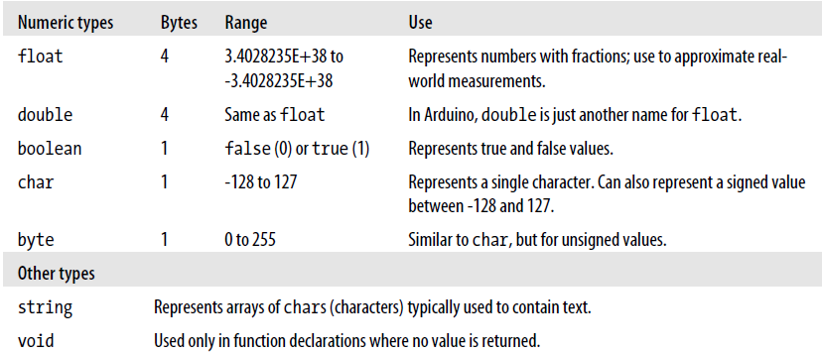
Arduino data types
The next few slides are mostly for reference
Most programming environments use these types similar ones

Slide 28
Flow control
Similar to other programming languages
1. if
if(expression){ //if expression is true
doSomething;
}
2. if… else
if(inputPin == HIGH){
doThingA;
} else{
doThingB;
}
3. for
for (initialization; condition; expression){
doSomething;
}
4. while
while (expression){
doSomething;
}
5. do… while
do {
doSomething;
} while (expression);
if (inputPin < 500){
doThingA;
}
else if (inputPin >= 1000){
doThingB;
}
else{
doThingC;
}
for(j=0; j < 4; j++ ){
Serial.println(j);
}
while (someVariable < 200){ //if less than 200
doSomething; // executes enclosed statements
someVariable++; // increments variable by 1
}
do{ // assign readSensors value to x
x = readSensors();
delay (50); // pauses 50 milliseconds
} while (x < 100); // loops if x is less than 100

Slide 29
Using Floating-Point Numbers
OUTPUT:
1.00
0.90
0.80
0.70
0.60
0.50
0.40
0.30
0.20
0.10
The value is close enough to zero
-0.10
-0.20
float value = 1.1;
void setup(){
Serial.begin(9600);
}
void loop(){
value = value - 0.1;
//reduce value by 0.1 each time through the loop
if( value == 0)
Serial.println("The value is exactly zero");
else if(fabs(value) < .0001)
//function to take the absolute value of a float
Serial.println("The value is close enough to zero");
else
Serial.println(value);
delay(100);
}
This is because the only memory-efficient way that floating-point numbers can contain the huge range in values they can represent is by storing an approximation of the number.
The solution to this is to check if a variable is close to the desired value.

Slide 30
Arrays
Arrays are zero indexed, with the first value in the array beginning at index number 0. An array needs to be declared and optionally assigned values before they can be used.
int myArray[] = {value0, value1, value2...}
Likewise it is possible to declare an array by declaring the array type and size and later assign values to an index position
int myArray[5]; // declares integer array with 5 positions
myArray[3] = 10; // assigns the 3rd index the value 10
To retrieve a value from an array, assign a variable to the array and index position:
first = myArray[0]; // this is the first element
last = myArray[4]; // this is the last element

Slide 31
Getting Started (1)
Arduino Software should be installed on Lab PCs
If not – install it from www.arduino.cc – Downloads
Start Arduino in Windows
And connect your Arduino

Slide 32
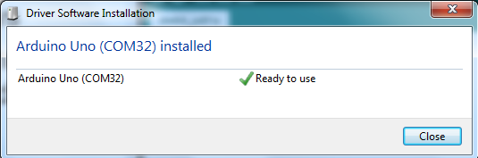
Getting Started (2)
Start Arduino in Windows
And connect your Arduino
You may see the driver installation if it has not been done already
You will see a different number for COMXX on your PC (probably a smaller number)

Slide 33
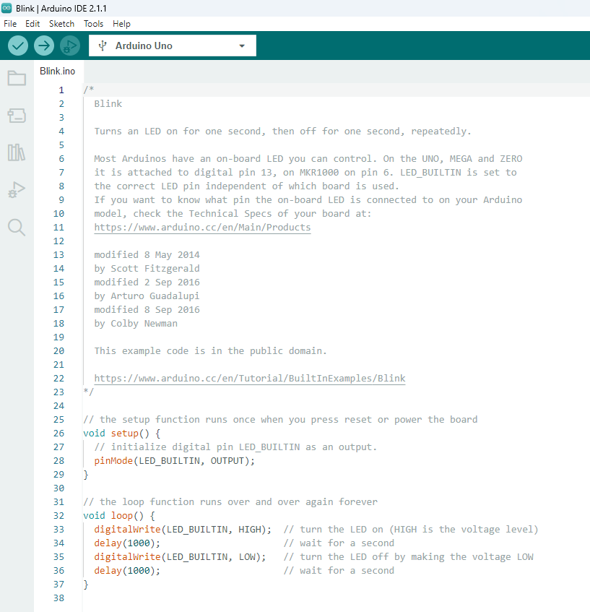
Getting Started (3)
Start Arduino in Windows
And connect your Arduino
This is the Arduino Opening Screen
(You may see a different sketch, depending on how the Arduino was used beforehand)

Slide 34
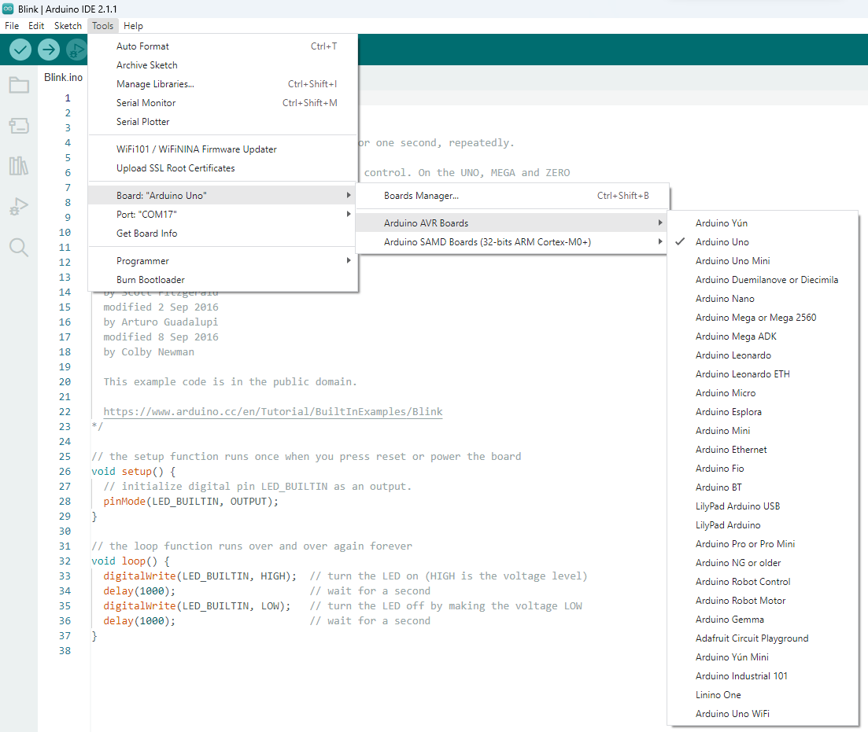
Tell Arduino what type of board you have
Arduino Uno

Slide 35
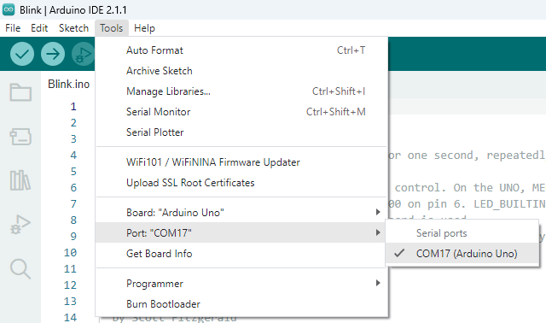
Tell Arduino what serial port you’re using
Select the COM port used in your PC
The COM port used in your computer will probably be different from COM17

Slide 36
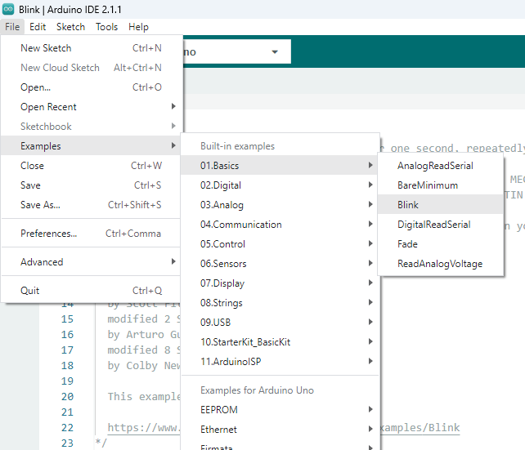
Load our first program (Sketch) Blink
Blink is a very simple demo program or sketch
Think of it as a kind of ‘hello world’ for Arduinos

Slide 37
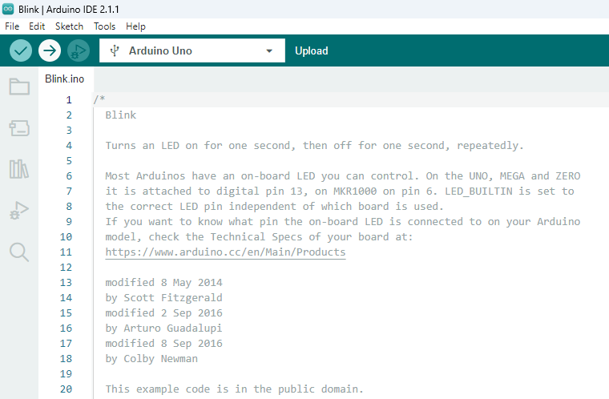
Load our first program (Sketch) Blink to the Arduino
This icon compiles your sketch, then loads it to the Arduino microcontroller
We’ll load Blink and see what’s going on

Slide 38
First simple exercise
Lab Exercise:
Download Blink to your Arduino Board
Check what happens
Change the on/off time (see the delay() function)
Try a few other example sketches and see how they work

Slide 39
So what have we learnt?
Computers come in all sorts of shapes and sizes
Embedded computers are everywhere
We use similar ideas to those used for all types of programming, taking into account the interaction with the outside physical world

